Slide 1
Global Healthcare Data ETL & Analysis CLI
- VAKA SRAVANTHI

Slide 2
INTRODUCTION
The Global Healthcare Data ETL & Analysis CLI project is a command-line based application that enables users to extract, process, and analyze historical COVID-19 and vaccination data for any country. The system connects to a public API that provides global healthcare statistics and retrieves the required data based on the selected country and date range.
Once the data is fetched, it undergoes a transformation process where missing values are handled, data types are standardized, and the structure is cleaned for consistency. The processed data is then loaded into a MySQL database, making it available for efficient storage and further analysis.
Users interact with the project through a simple and intuitive CLI (Command-Line Interface). Various operations are supported, including:
Fetching country-specific data
Generating analytical insights such as total cases, daily trends, and top affected countries
Managing the database by listing or dropping tables
This project showcases how Python can be used to build a complete backend solution that automates data extraction, transformation, storage, and analysis all within a terminal environment. It also strengthens the understanding of working with APIs, performing data cleaning, writing SQL queries, and building modular CLI-based applications

Slide 3
PROBLEM STATEMENT
In today’s digital world, having access to reliable and structured healthcare data is essential for understanding and responding to public health crises like COVID-19. While there are public APIs that provide historical COVID-19 data, the data is often in a raw, unstructured format that is difficult to use for direct analysis.
Working with such data presents several challenges:
The data may contain missing values, inconsistent formats, or duplicates
It is not directly ready for use in databases or analytical tools
Manual processing is time-consuming and prone to errors
There is a strong need for a system that can:
Automatically extract healthcare data from a reliable public source
Transform and clean the data for consistency and accuracy
Store it in a structured format like a relational database
Provide an easy way for users to query and analyze the data

Slide 4
PROJECT OBJECTIVES
The goal of this project is to develop a command-line based Python application that automates the process of collecting, transforming, storing, and analyzing COVID-19 data. It focuses on building a complete and modular data pipeline that connects to a public API, cleans the incoming data, stores it in a MySQL database, and allows users to interact through simple CLI commands.
Key Objectives:
To Extract historical COVID-19 vaccination data from a trusted public API based on country and date range
To Transform raw data by handling missing values, correcting data types, and ensuring consistent formatting
To Load the cleaned and structured data into a MySQL database for reliable storage and access
To provide a user-friendly Command-Line Interface (CLI) for performing all operations seamlessly
To enable analytical queries such as total cases, daily trends, recovery rates, and top affected countries
To maintain a modular, reusable, and error-resilient codebase with proper logging and validations

Slide 5
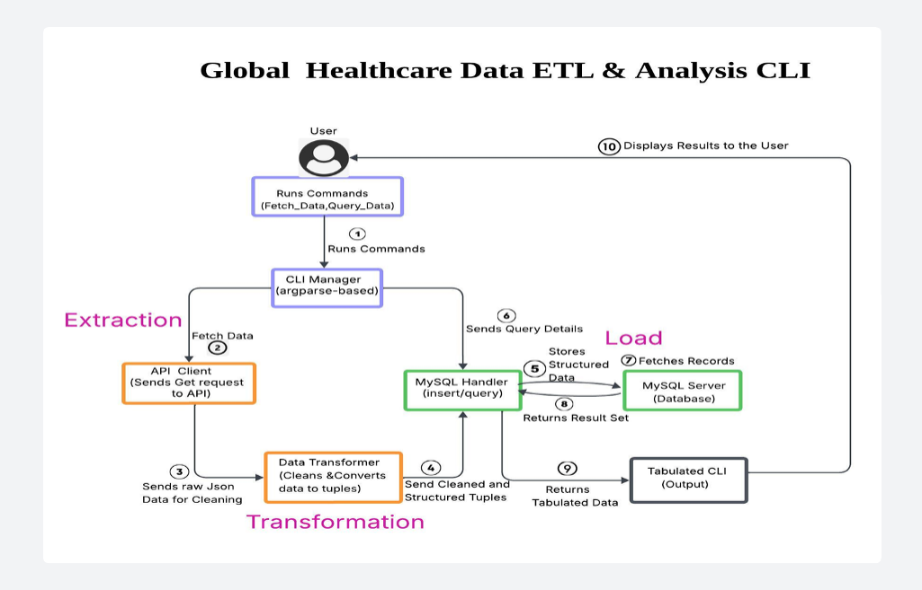
SYSTEM ARCHITECTURE

Slide 6

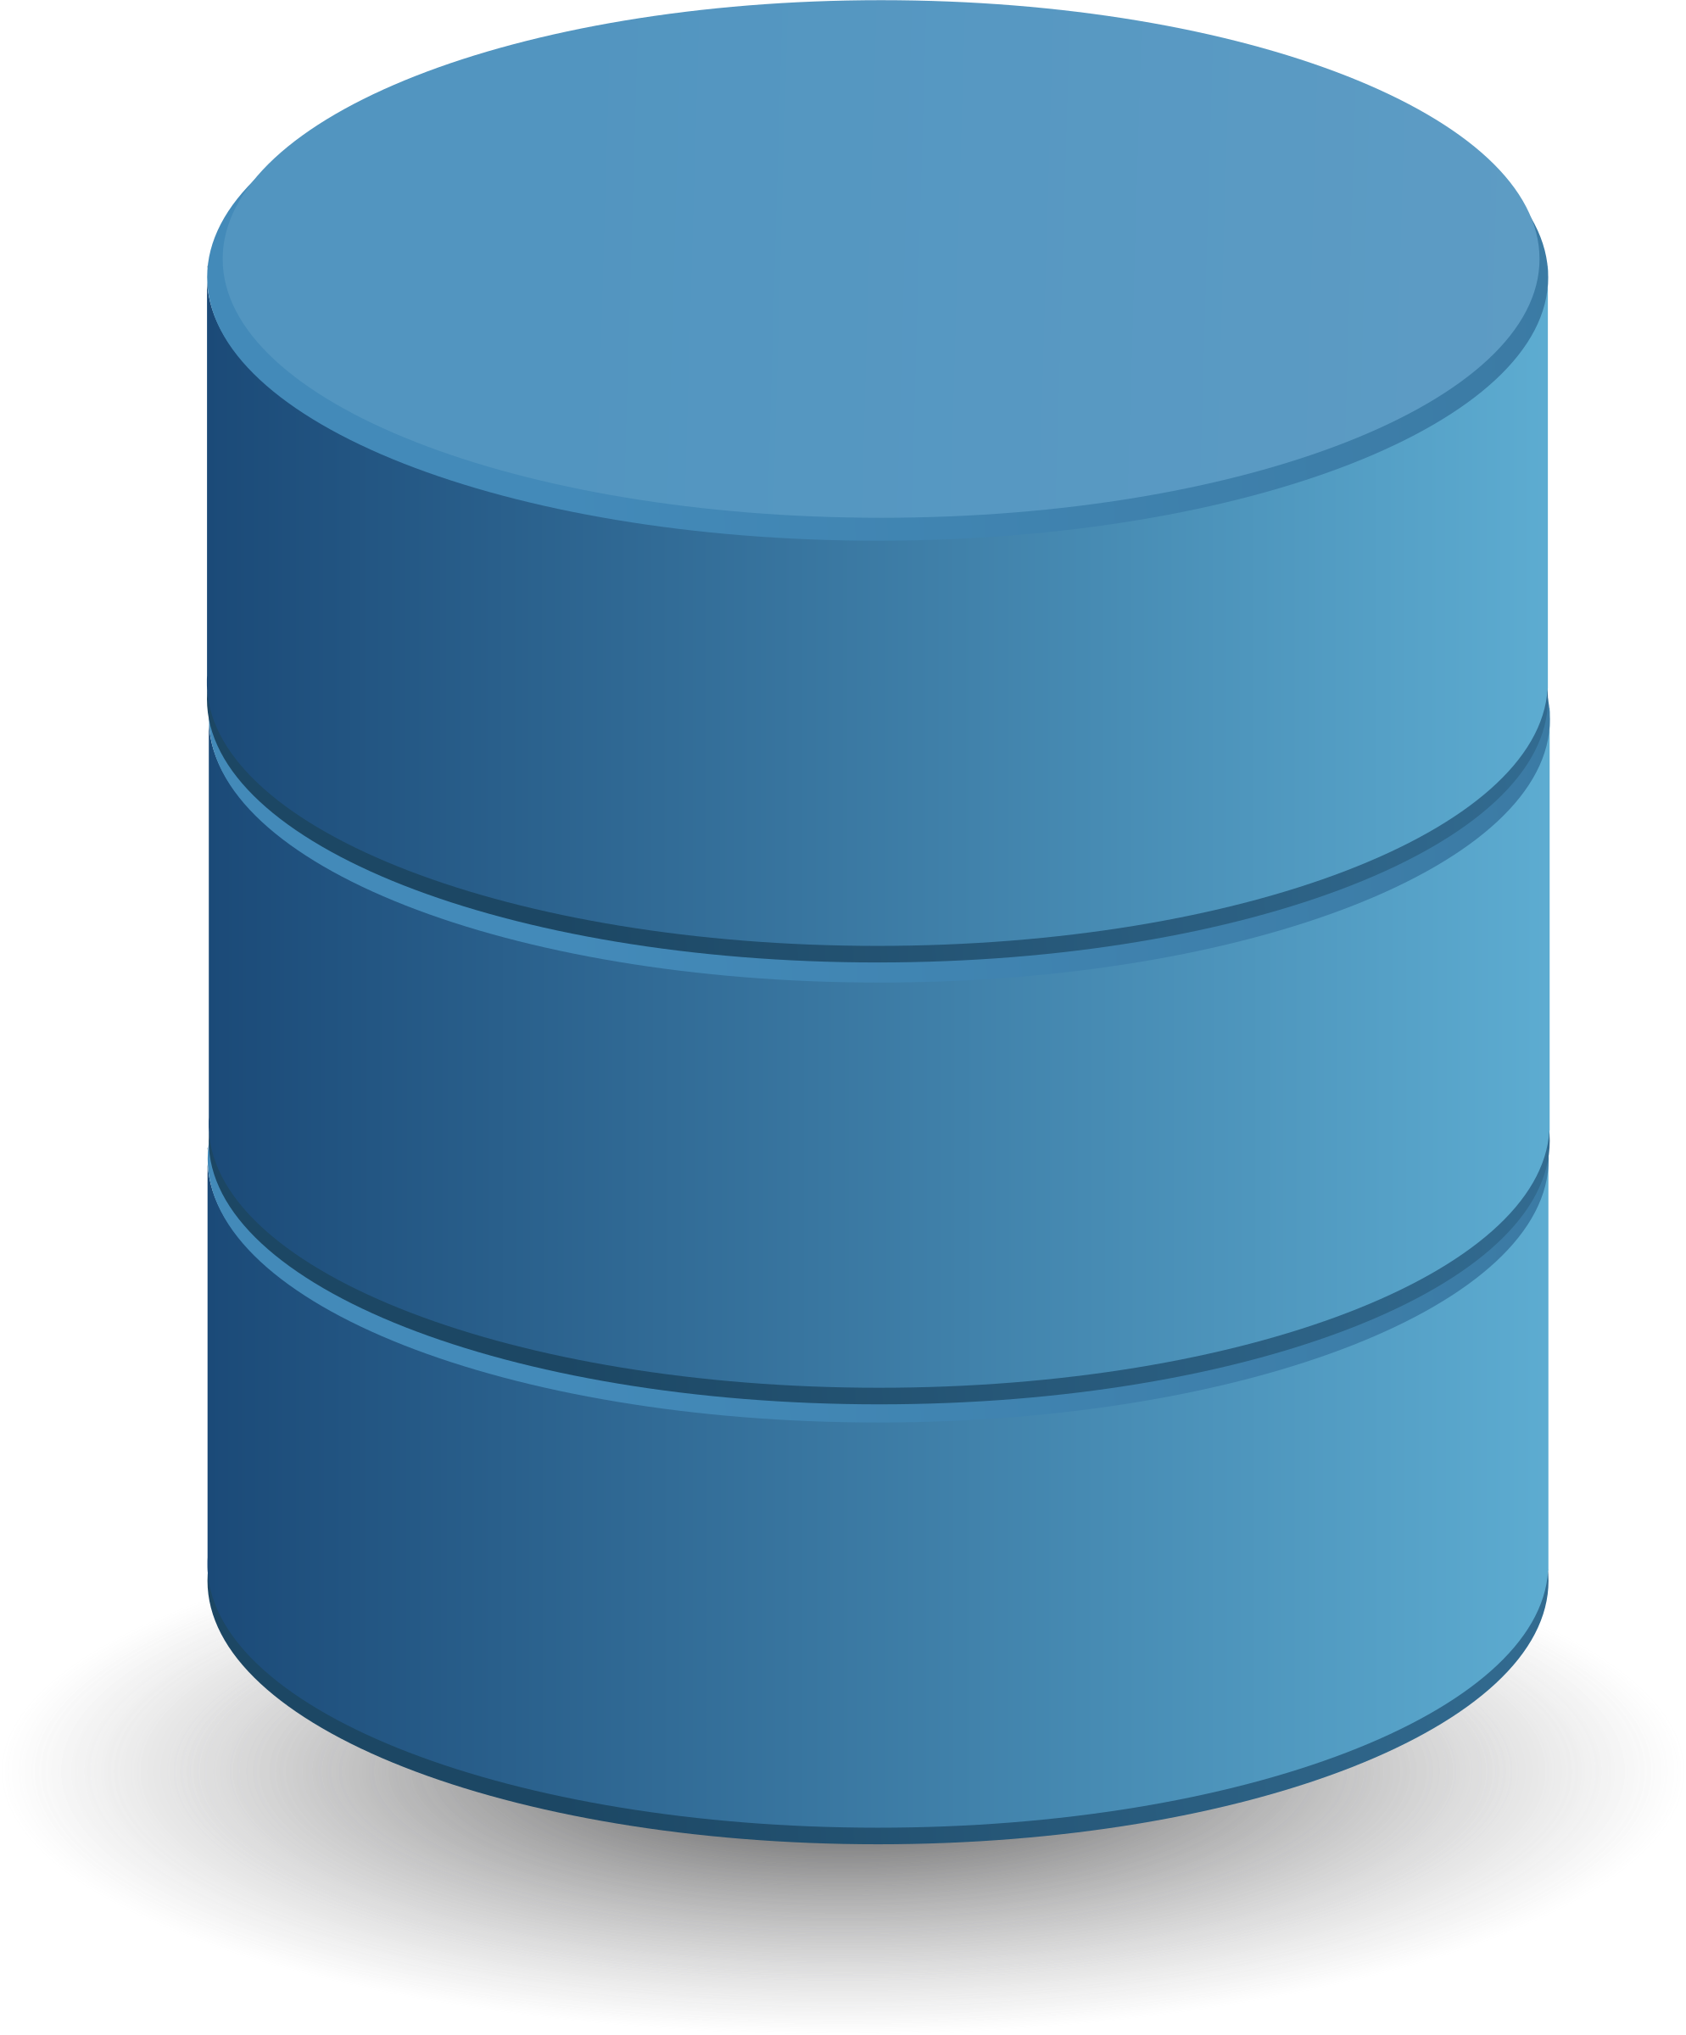


SKILLS & TECHNOLOGIES USED
Programming Language
Python – For scripting, API integration, data transformation, and CLI development
Database
MySQL – For relational data storage, table management, and executing analytical SQL queries
API Source
disease.sh – For fetching real-time and historical COVID-19 data based on country and date
Libraries
requests – For making HTTP requests to access API data
mysql-connector-python – For database connectivity and SQL execution
tabulate – For displaying CLI outputs in a formatted tabular structure
Modules
argparse – For parsing and handling command-line arguments
configparser – For managing settings through external configuration files
logging – For logging errors, status messages, and debug info
Skills Applied
Git – For version control and project tracking
Data Analysis – For deriving trends and summaries using SQL queries
Data Manipulation – For cleaning, filtering, and formatting raw JSON data
🧩
🧠

Slide 7
METHODOLOGIES
Data Extraction
COVID-19 historical data is extracted from the public API at https://disease.sh/v3/covid-19/historical.
Users provide input parameters like country, start date, and end date via CLI.
The api_client.py module sends a request and retrieves the JSON response containing time-series data.
Data Transformation
The raw API data is cleaned and structured using the data_transformer.py module
Operations include:
Filtering data by date range and country.
Flattening nested JSON fields.
Converting string dates into datetime objects.
Handling missing or null values.
Structuring data for insertion into database tables.
Data Loading
Transformed data is inserted into a MySQL database using the mysql_handler.py module.
Steps involved:
Establishing a database connection via credentials from config.ini.
Creating necessary tables from create_tables.sql if they don’t exist.
Using parameterized SQL queries to insert records.
Ensuring transaction safety through commits and error handling

Slide 8
Command-Line Interface (CLI) Integration
A user-friendly CLI is implemented using Python’s argparse library in main.py.
Supported commands:
fetch_data: Trigger ETL for a specific country and date range.
list_tables: Display all tables in the database.
query_data: Execute analytical queries.
drop_tables: Remove all related tables from the database.
Data Analysis and Querying
Error Handling and Validation
Users can perform analysis through predefined query types like:
total_cases <country>
daily_trends <country> <metric>
top_n_countries_by_metric <n> <metric>
Results are displayed in a readable table format using the tabulate library
Input validation is performed to ensure correct country names, date formats, and arguments.
Network/API errors, database failures, and data inconsistencies are handled using try-except blocks.
All modules are designed to fail gracefully with meaningful error messages.

Slide 9
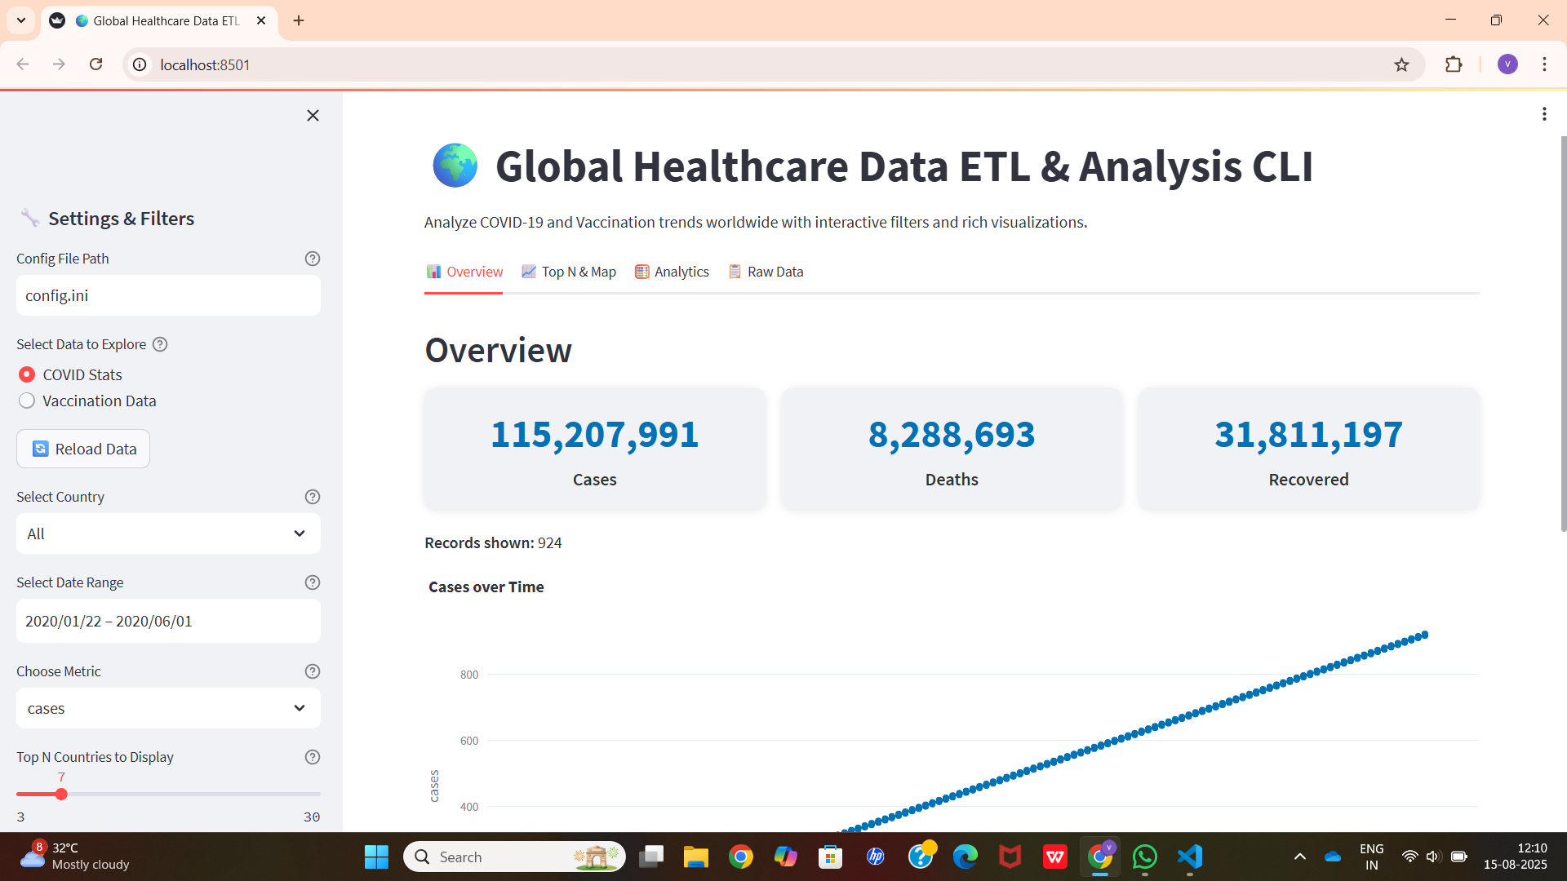
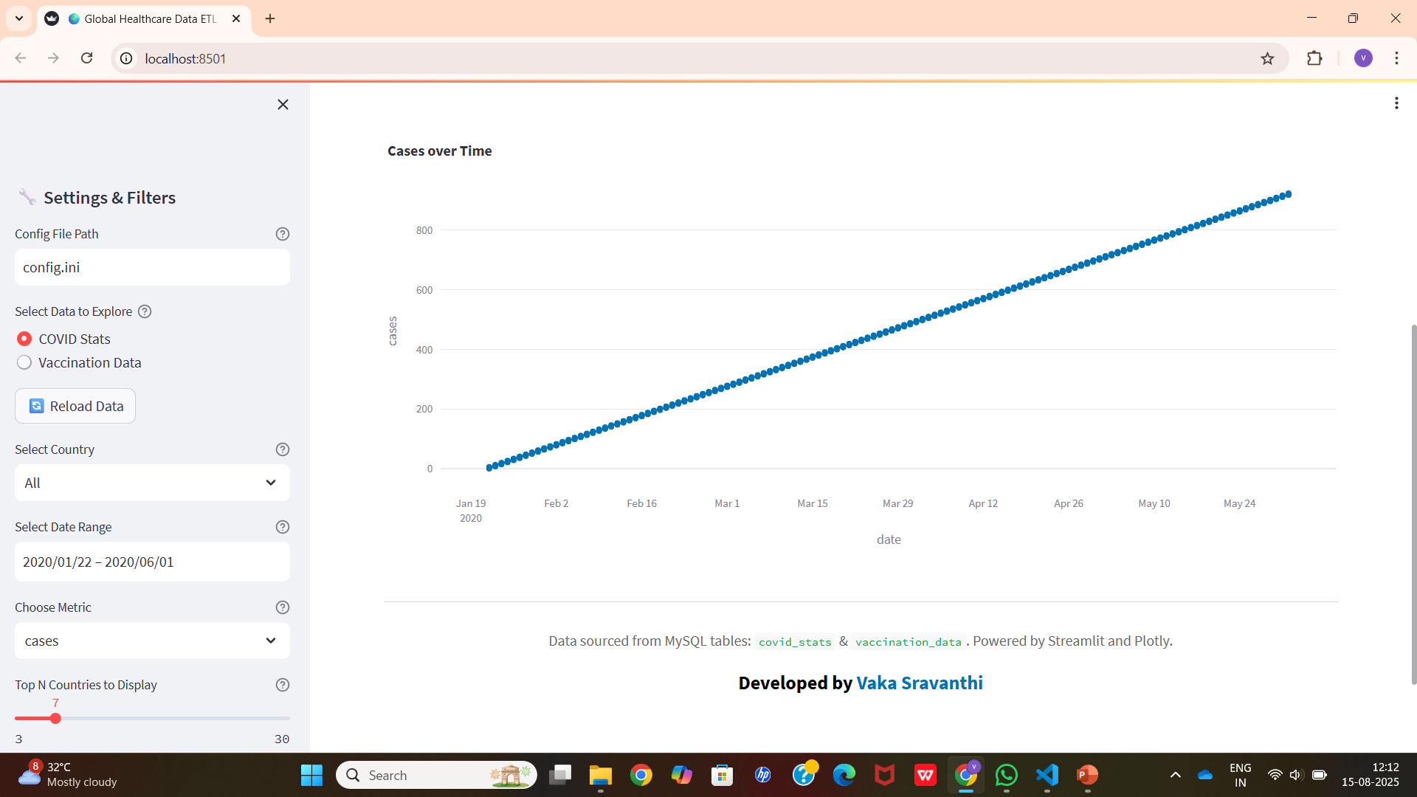
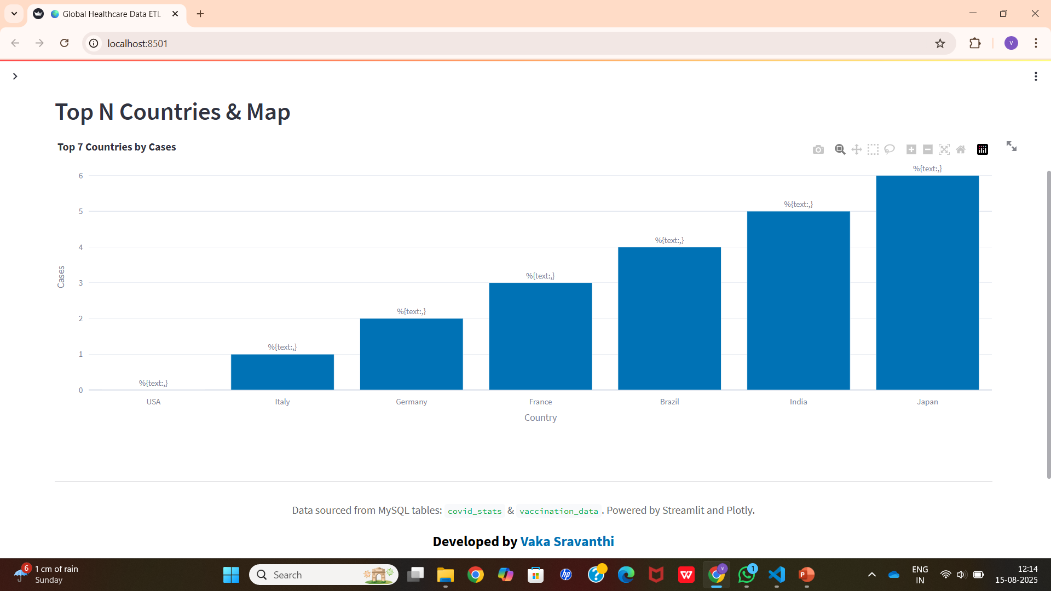
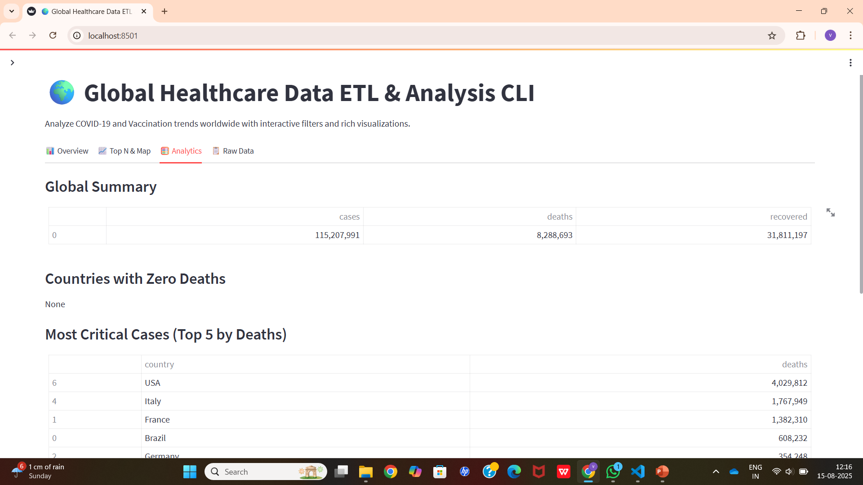
DASHBOARD
Click->[Click to View Dashboard]

Slide 10
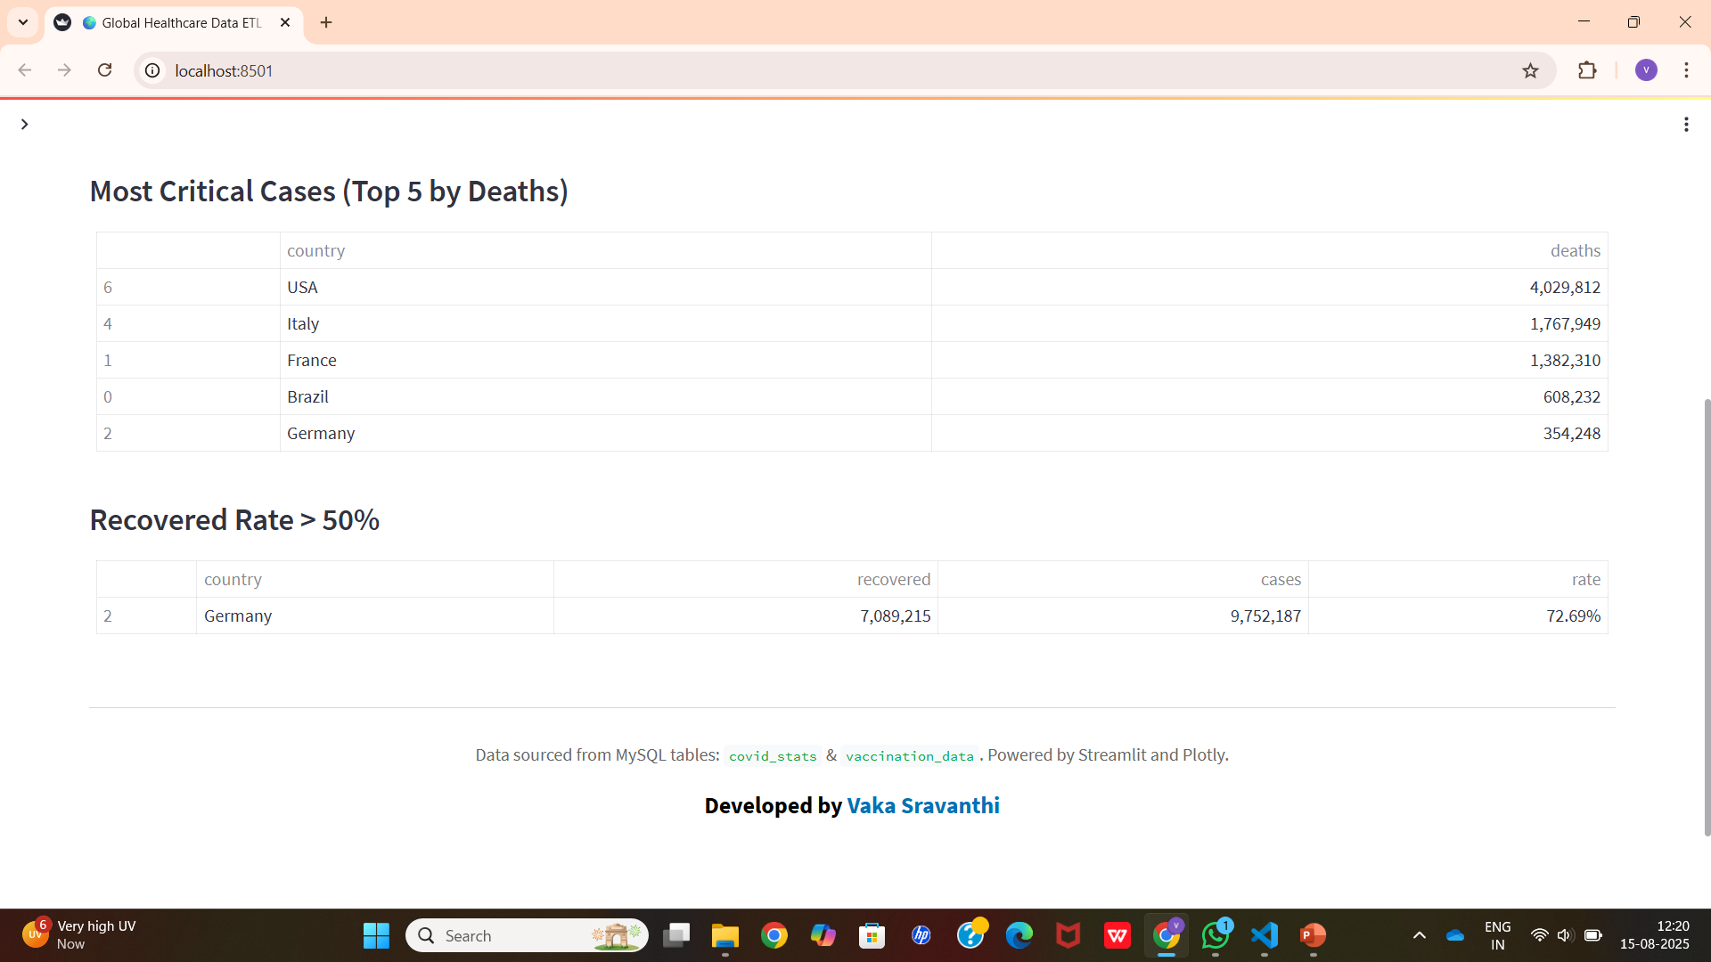
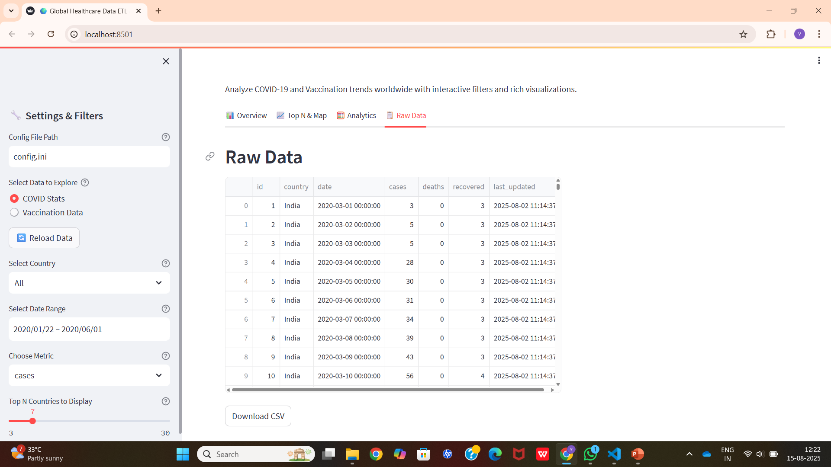
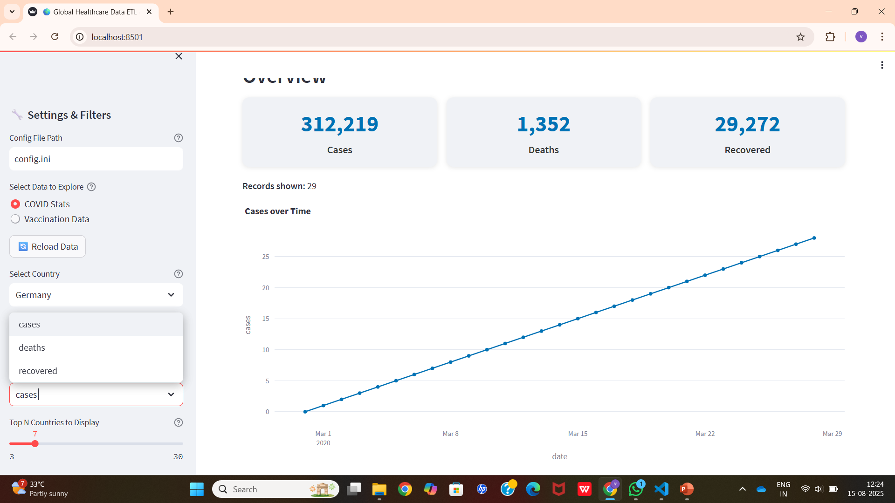
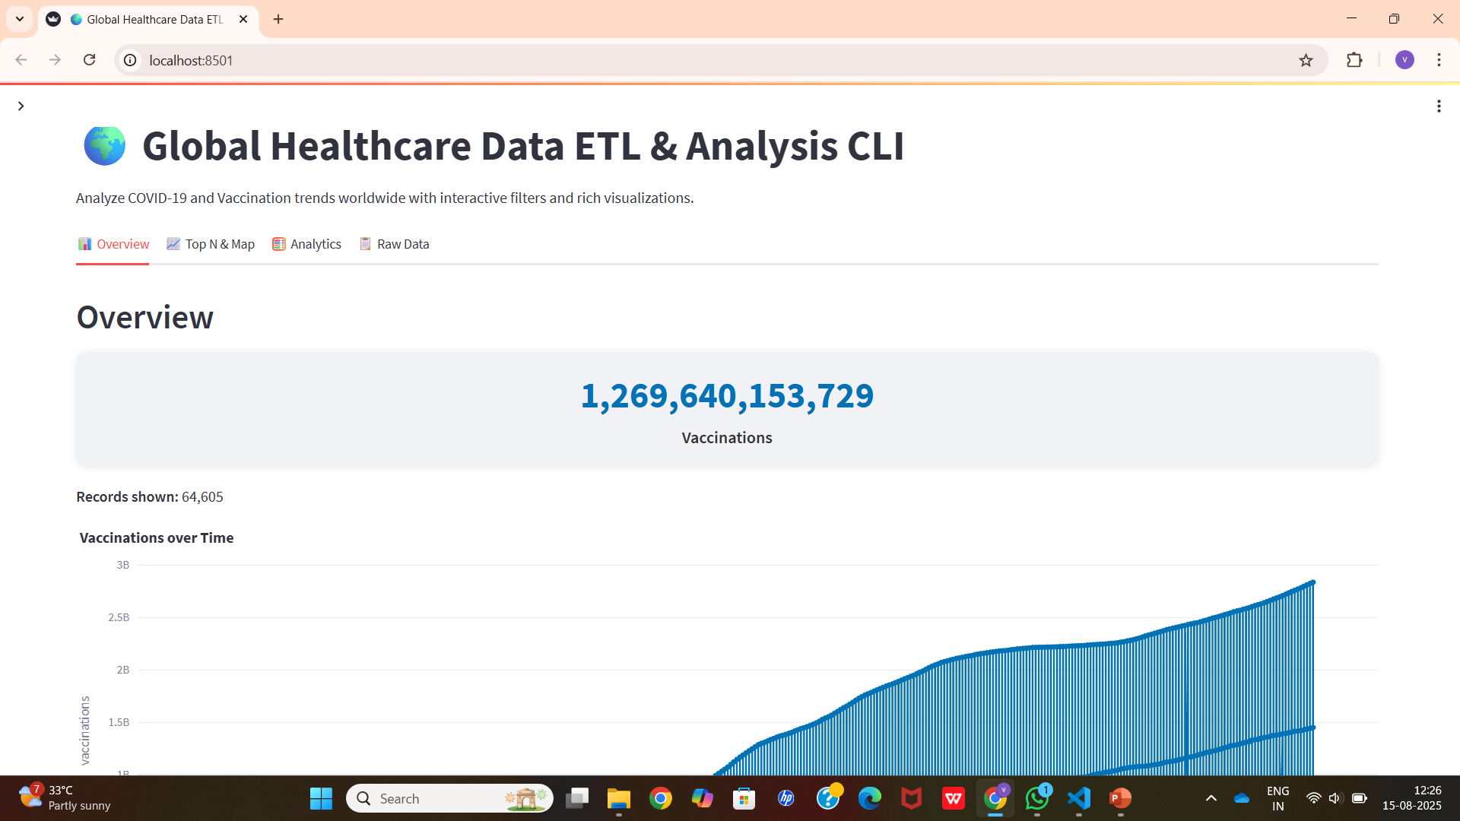

Slide 11
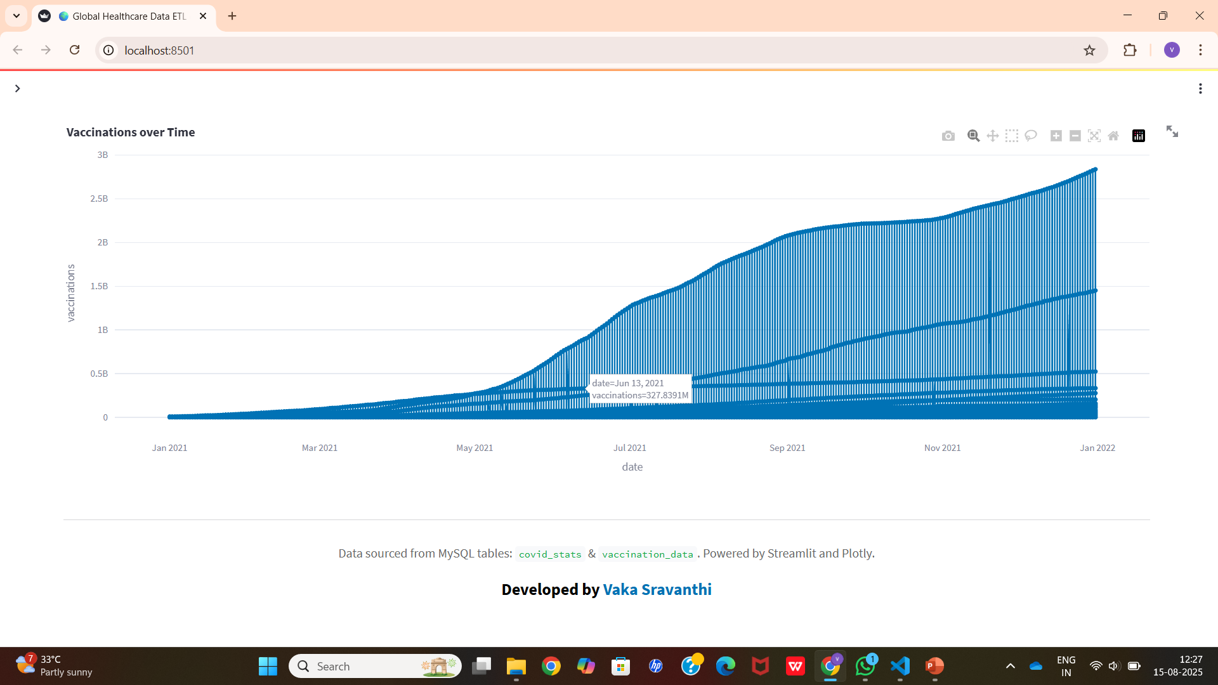
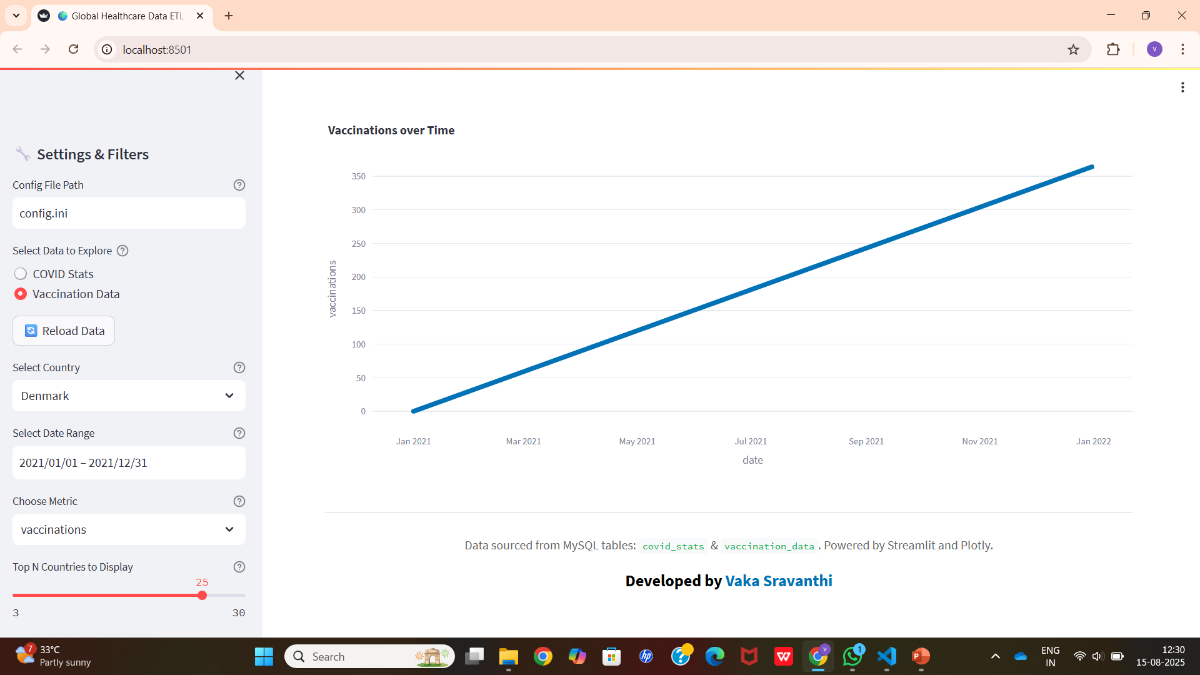
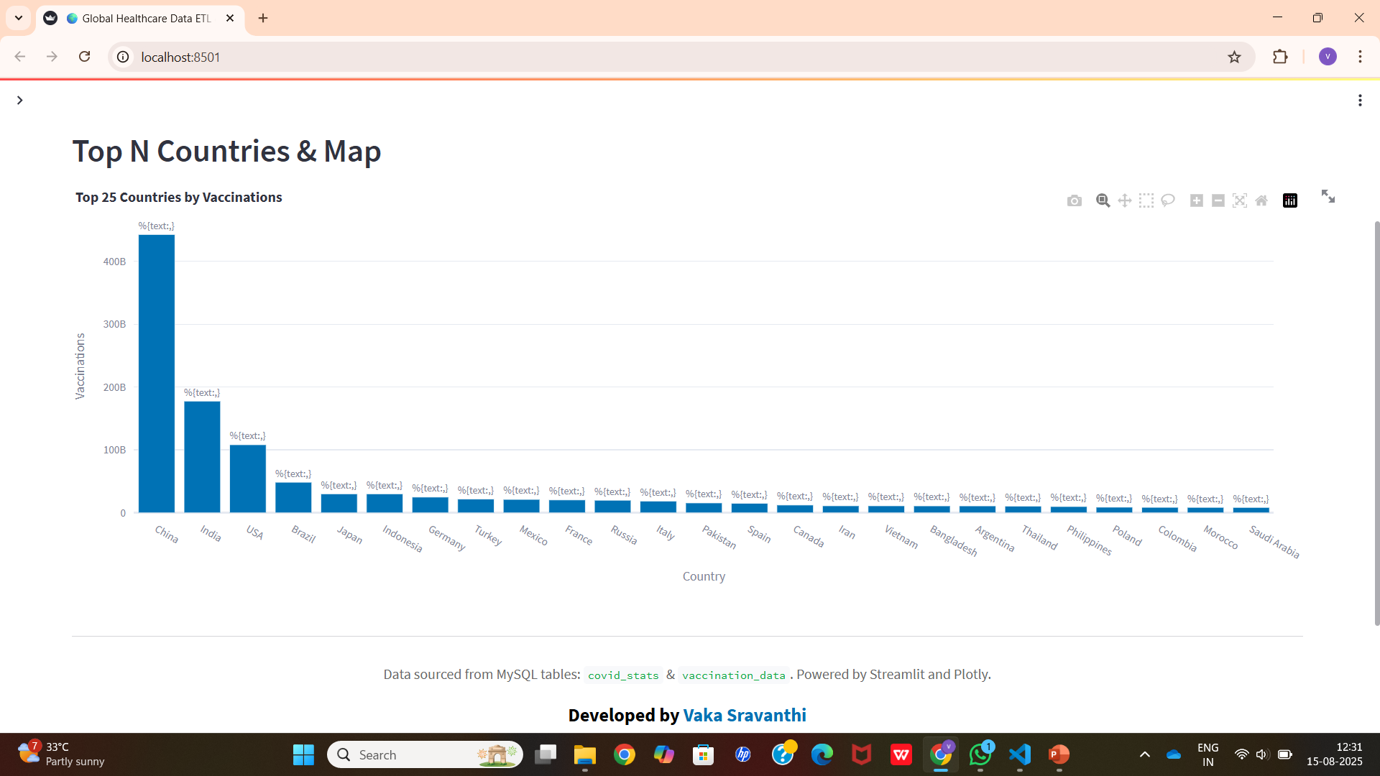
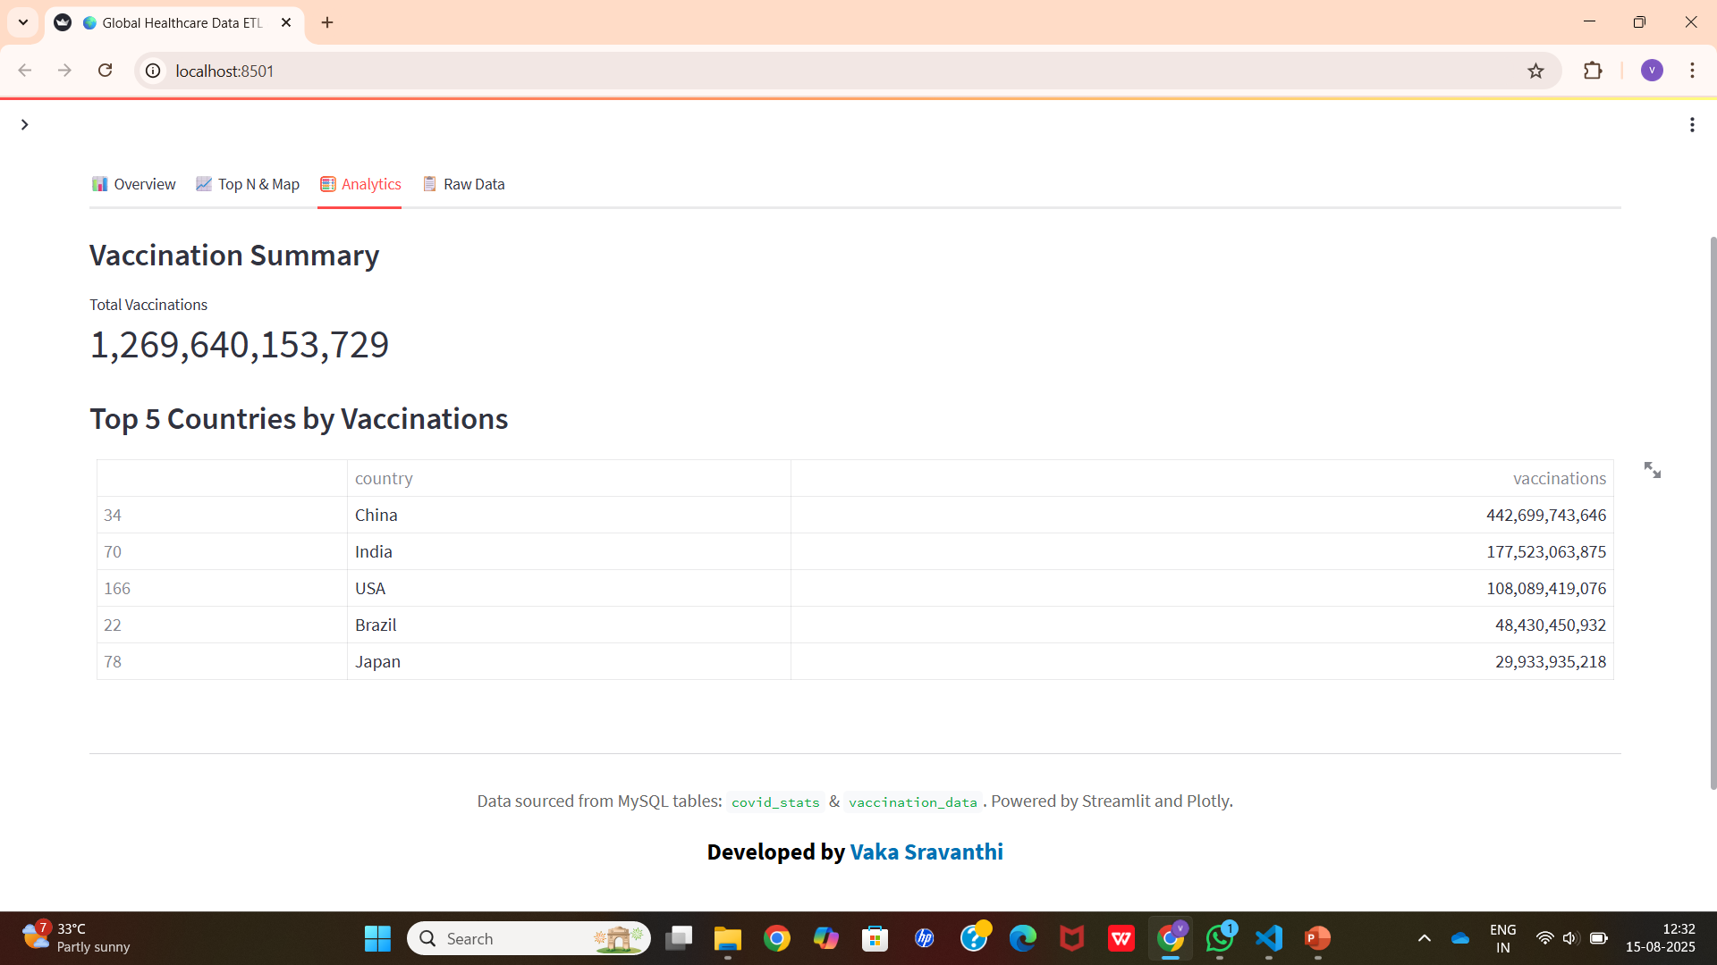

Slide 12
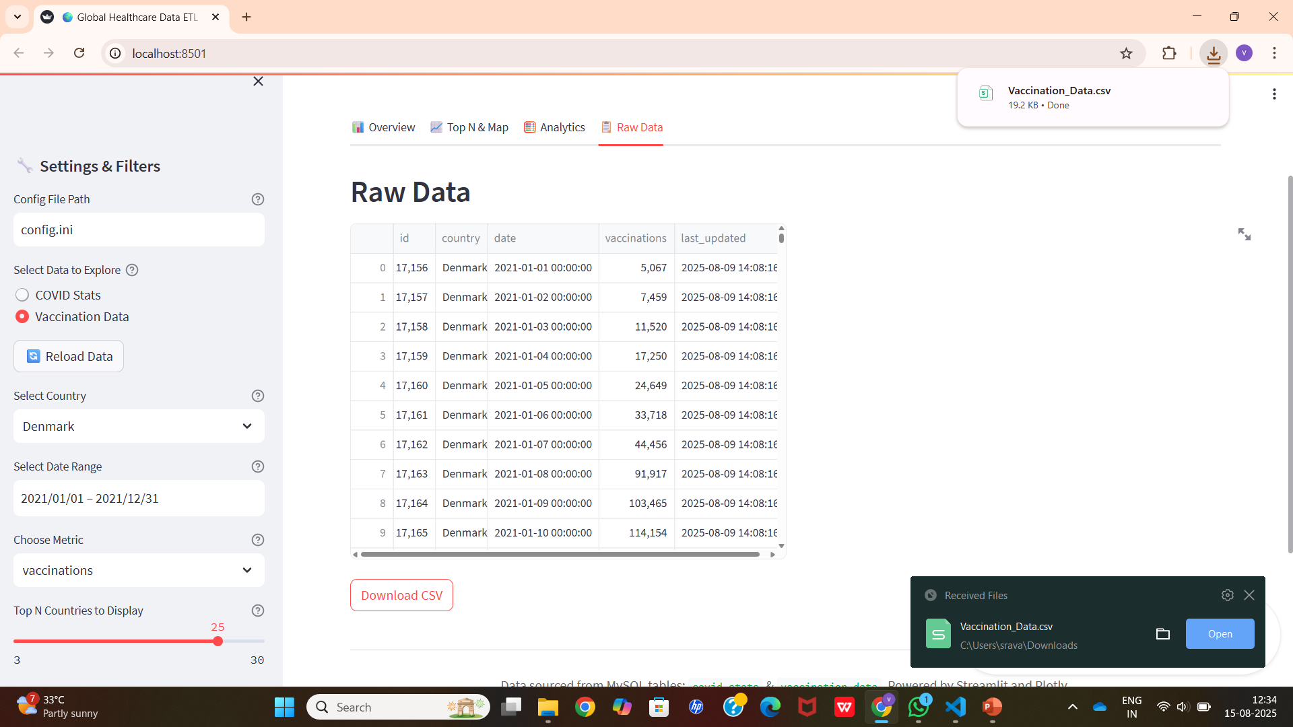

Slide 13
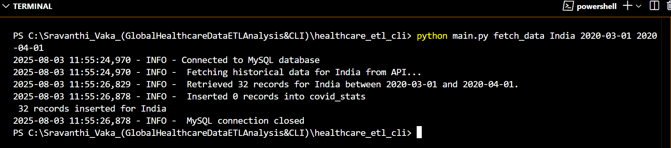
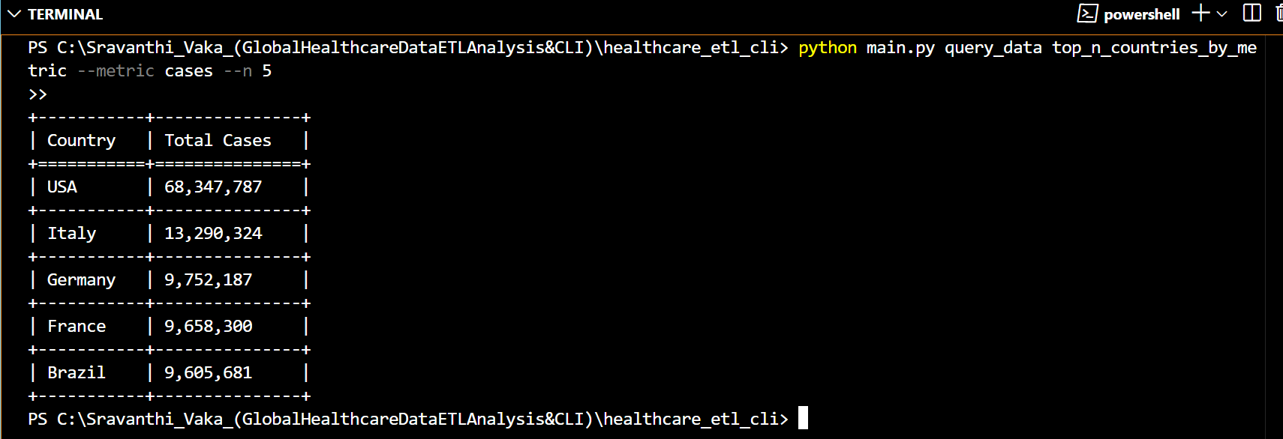
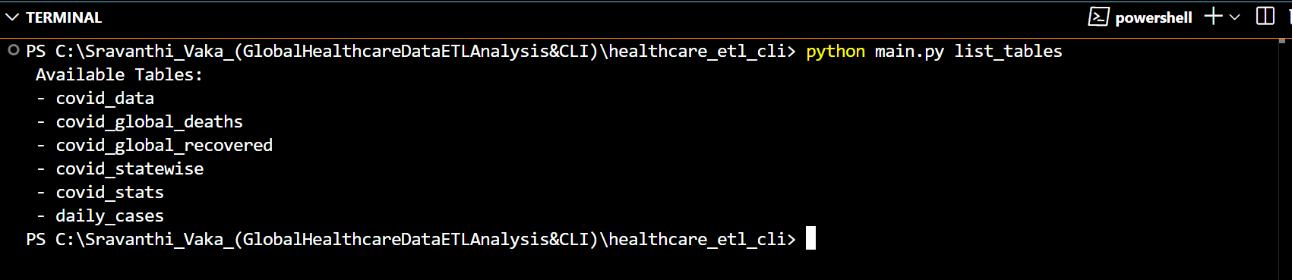
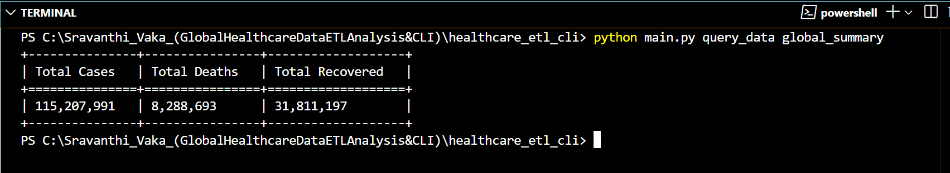
Execution Outputs
1)Fetching Data 3)Querying Data-Top Countries by Metric
2)Listing Tables 4) Global Summary

Slide 14
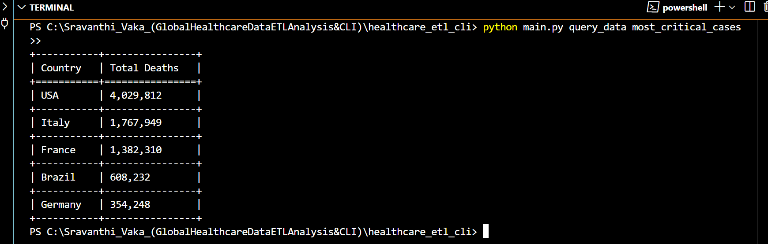
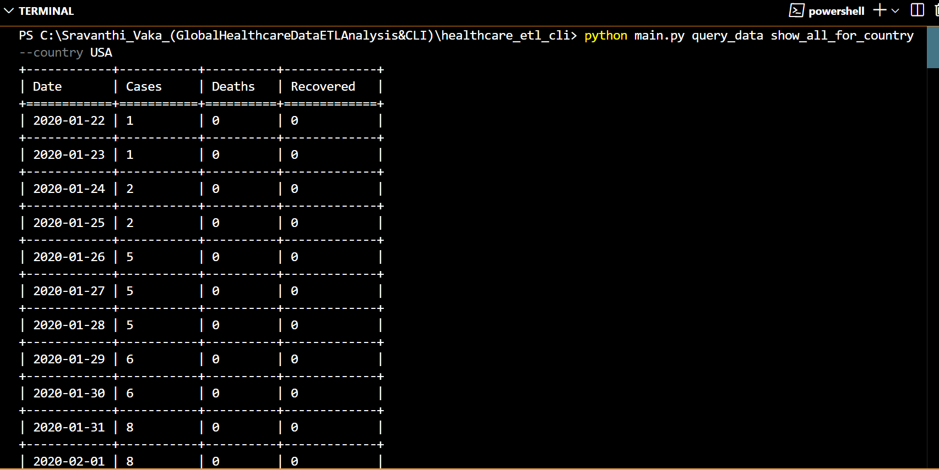
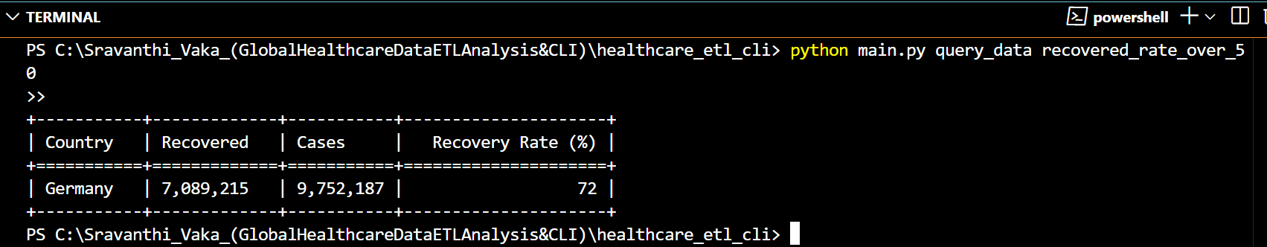
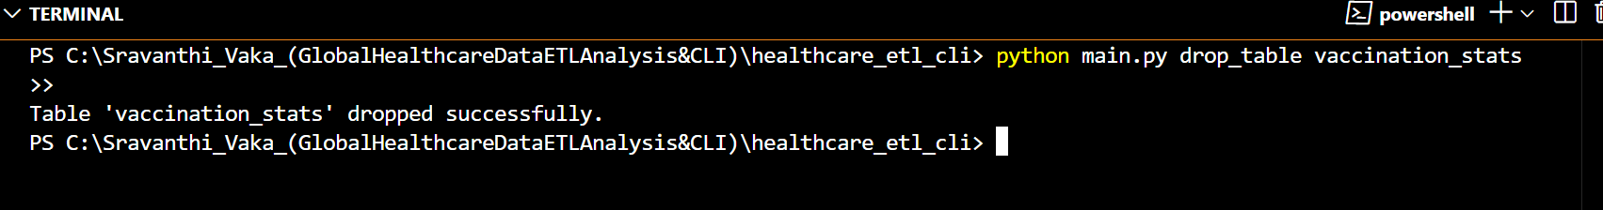
5)Most Critical Countries by Deaths 6) Complete COVID-19 History for USA
7)Countries with Recovery Rate Over 50% 8) CLI: Dropping a Specific Table

Slide 15
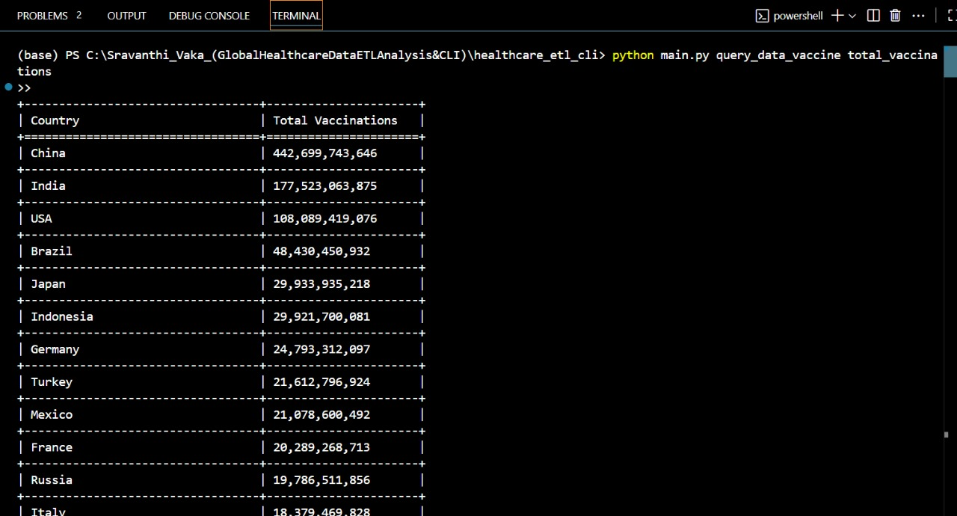
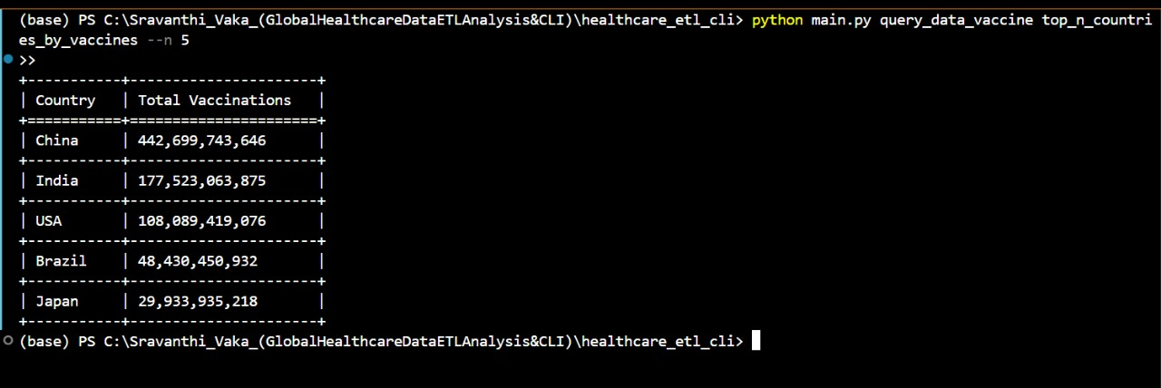
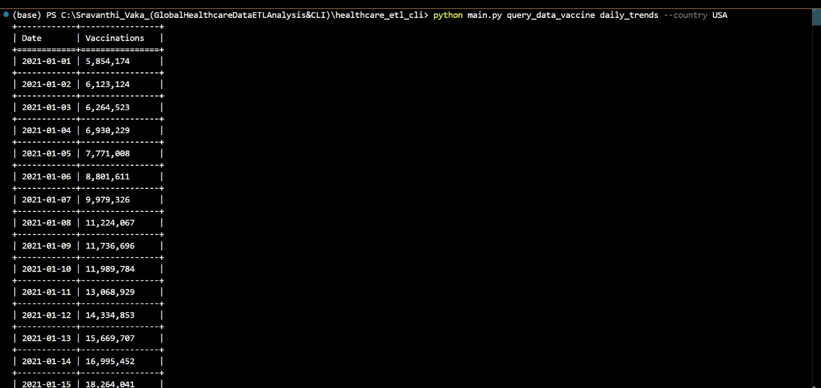
9)Total COVID-19 Vaccinations by Country
10)Top 5 Countries by Total COVID-19 Vaccinations
11)Daily COVID-19 Vaccination Trends in USA

Slide 16


